Slide 1
WARM UP!
Here is the estimated battery life for each of nine different smart phones (in minutes) according to http://cell-phones.toptenreviews.com/smartphones.
Make a dotplot of the data and then describe the distribution.
SMART PHONE | BATTERY LIFE (minutes)
Apple iPhone | 300
Motorola Droid | 385
Palm Pre | 300
Blackberry Bold | 360
Blackberry Storm | 330
Motorola Cliq | 360
Samsung Moment | 330
Blackberry Tour | 300
HTC Droid | 460

Slide 2
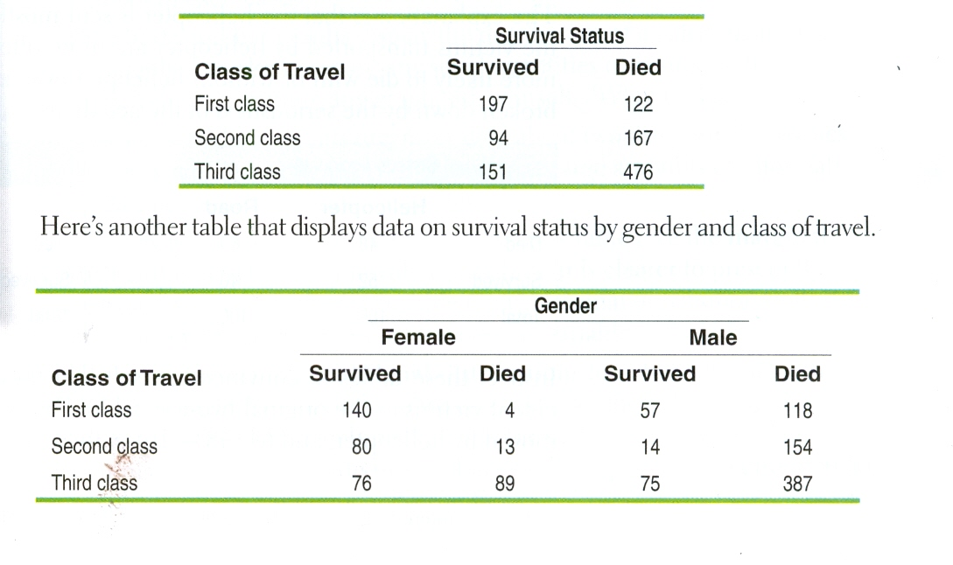
The TITANIC
In 1912 the luxury liner Titanic, on its first voyage across the Atlantic, struck an iceberg and sank. Some passengers got off the ship in lifeboats, but many died. The two-way table below gives information about adult passengers who lived and who died, by class of travel.
http://www.zuguide.com/#Titanic
  This movie suggested the following: First-class passengers received special treatment in boarding the lifeboats, while some other passengers were prevented from doing so (especially third-class passengers)
  Women and children boarded the lifeboats first, followed by the men.
What do the data tell us about these two suggestions?

Slide 3
Displaying Categorical Data & Quantitative Data
Unit 1 Day 2 Notes

Slide 4
Distribution of a Categorical Variable
Frequency Table
Relative Frequency Table
Format | Percent of Stations
Adult Contemp.
Adult Standards
Contemporary Hit
Country
News/Talk/Info
Oldies
Religious
Rock
Spanish Language
Other formats
Total
Format | Count of Stations
Adult Contemp. | 1,556
Adult Standards | 1,196
Contemporary Hit | 569
Country | 2,066
News/Talk/Info | 2,179
Oldies | 1,060
Religious | 2,014
Rock | 869
Spanish Language | 750
Other formats | 1,579
Total | 13,838
Format | Percent of Stations
Adult Contemp. | 11.2
Adult Standards | 8.6
Contemporary Hit | 4.1
Country | 14.9
News/Talk/Info | 15.7
Oldies | 7.7
Religious | 14.6
Rock | 6.3
Spanish Language | 5.4
Other formats | 11.4
Total | 99.9
Displays the COUNTS
Displays the PERCENTS
This should be 100% - It is a roundoff error affected by our rounding in the table

Slide 5
Displaying Variables
(refer to Graph Types Worksheet)
Categorical
Quantitative
Pie Chart
  Can use to show counts or percents, but must include all categories to make up a whole
Bar Graph (or Bar Chart)
  Easier to make the pie charts – the categories are labeled on the horizontal axis for each bar
Dot Plot
  Good for smaller data sets.
  Each data value is shown as a dot above its location on a number line.
Stemplot
  Good for smaller data sets.
  Gives a quick picture of the shape of a distribution while including the actual numerical values in the graph.
Histogram
  The most common graph of the distribution of one quantitative variable

Slide 6
No Matter What Type of Graph you Make…
TITLE the graph
LABEL the graph
CREATE a key, if necessary
Make sure the graph is not misleading and the scaling is correct.

Slide 7
Let’s start with…
Analyzing CATEGORICAL Data

Slide 8
Two Way Tables (aka Contingency Tables)
A survey of 4826 randomly selected young adults (aged 19 – 25) asked, “What do you think are the chances you will have much more than a middle-class income at age 30?”. The table below shows the responses, omitting a few people who refused to respond of who said they were already rich.
Young Adults by gender and chance of getting rich
 | Gender
Opinion | Female | Male | Total
Almost no chance | 96 | 98 | 194
Some chance but probably not | 426 | 286 | 712
A 50-50 chance | 696 | 720 | 1416
A good chance | 663 | 758 | 1421
Almost certain | 486 | 597 | 1083
Total | 2367 | 2459 | 4826

Slide 9
Marginal Distribution
Row total/ total total OR Column total/ total total
Example:
  Females who participated in the study was 2367/4826 or 49%.
  Males who participated in the study was 2459/4826 or 51%.
Example: Students who thought they had almost no chance of making much more than a middle-class income at age 30 is 194/4826 or 4%
 | Gender
Opinion | Female | Male | Total
Almost no chance | 96 | 98 | 194
Some chance but probably not | 426 | 286 | 712
A 50-50 chance | 696 | 720 | 1416
A good chance | 663 | 758 | 1421
Almost certain | 486 | 597 | 1083
Total | 2367 | 2459 | 4826

Slide 10
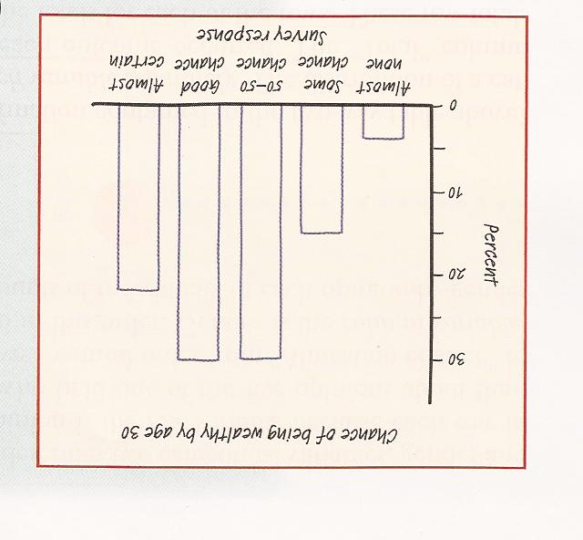
In this case, marginal distribution can show distribution of the opinion alone or the gender alone.
Here is a bar graph showing the marginal distribution of opinion about chance of being rich by age 30.
However, this tells us nothing about the relationship between two variables.

Slide 11
Conditional Distribution
Cell/ row total OR Cell/column total
Example:
  The conditional distribution of gender among those who responded “Almost Certain”
  Female: 486/1083 or 44.9%
  Male: 597/1083 or 55.1%
At your seats, compute the other conditional distributions of gender for the other five opinions.
 | Gender
Opinion | Female | Male | Total
Almost no chance | 96 | 98 | 194
Some chance but probably not | 426 | 286 | 712
A 50-50 chance | 696 | 720 | 1416
A good chance | 663 | 758 | 1421
Almost certain | 486 | 597 | 1083
Total | 2367 | 2459 | 4826

Slide 12
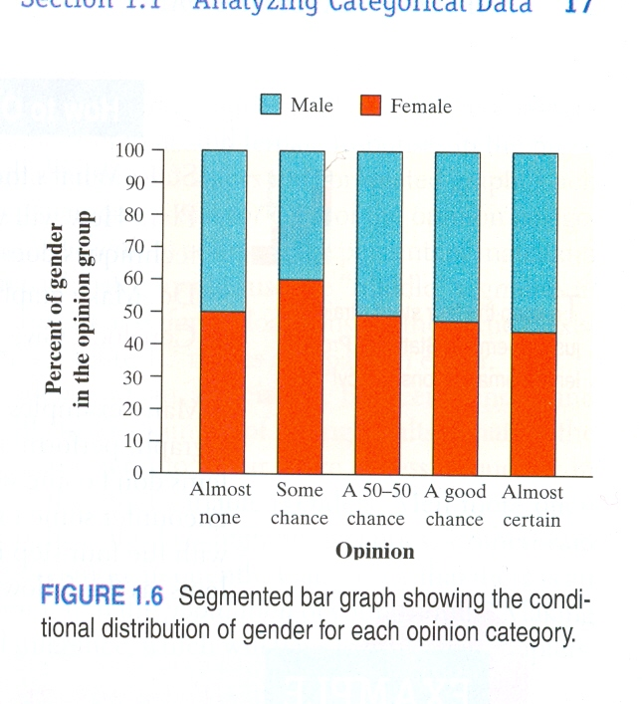
Segmented Bar graph
Showing the conditional distribution of gender for each opinion category

Slide 13
Conditional distributions and relationships
Based on the survey data, can we conclude that young men and women differ in their opinions about the likelihood of future wealth? Give appropriate evidence to support your answer.

Slide 14
HOLD UP!!!
Before we answer, here’s a hint on how to ORGANIZE A STATISTICAL PROBLEM
(This 4-step approach can be used with almost all stat problems!)
STATE
  What’s the question that you’re trying to answer?
PLAN
  How will you go about answering the question? What statistical techniques does this problem call for?
DO
  Make graphs and carry out needed calculations.
CONCLUDE
  Give your practical conclusion in the context of the real-world problem.

Slide 15
  STATE - What’s the question that you’re trying to answer?
What is the relationship between gender and responses to the question “What do you think are the chances you will have much than a middle-class income at age 30?

Slide 16
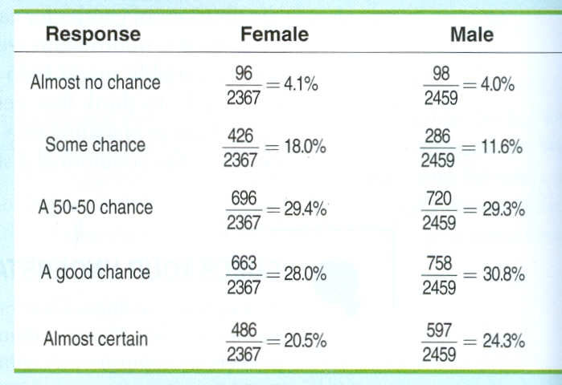
  PLAN - How will you go about answering the question? What statistical techniques does this problem call for?
We suspect that gender might influence a young adult’s opinion about the chance of getting rich. So we’ll compare the conditional distributions of response for men alone and women alone.

Slide 17
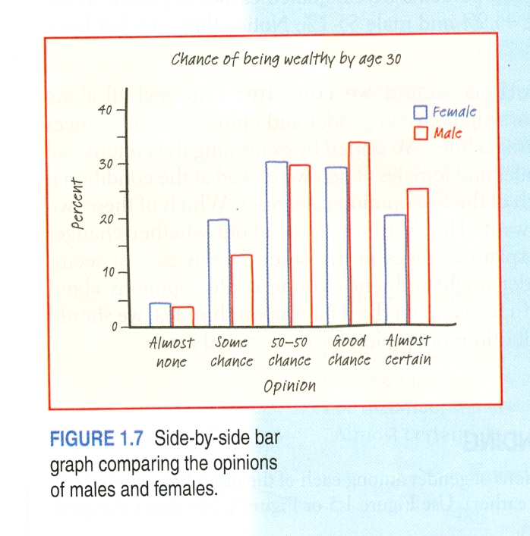
  DO - Make graphs and carry out needed calculations.
We’ll make a side-by-side bar graph to compare the opinions of males and females.

Slide 18
  CONCLUDE - Give your practical conclusion to the setting of the real-world problem.
In this part, you are looking for an association between two variables – specific values of one variable tend to occur in common with specific values of the other. If there is no association, we say that they are independent – they both have similar values.
Based on the sample data, men seem somewhat more optimistic about their future income than women. Men were less likely to say that they have “some chance but probably not” than women (11.6% vs. 18%). Men were more likely to say that they have “a good chance” (30.8% vs. 28.0%) or are “almost certain” (24.3% vs. 20.5%) to have much more than a middles-class income by age 30 than women were.

Slide 19
Let’s continue with…
QUANTITATIVE Data

Slide 20
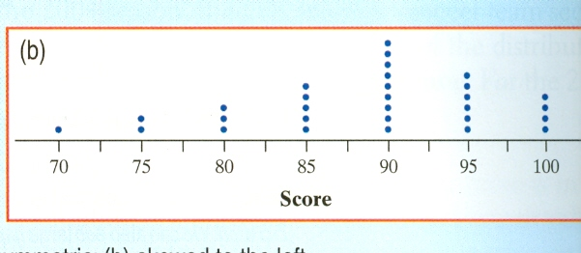
Dot Plots
One of the simplest graphs to construct
Each data value is shown as a dot (or X) above its location on a number line
AP Statistics class first quiz scores

Slide 21
Analyze this Data Plot
AP Statistics class’ first quiz score

Slide 22
Stem and Leaf Plots
Easy for smaller data sets
A group of AP Statistics students made a survey – selected a random sample of 20 female students recording the number of pairs of shoes they owned
50 26 26 31 57 19 24 22 23 38
13 50 13 34 23 30 49 13 15 51
1.) Make stems (minimum of 5)
2.) Add leaves
3.) Order Leaves
4.) Add a key

Slide 23
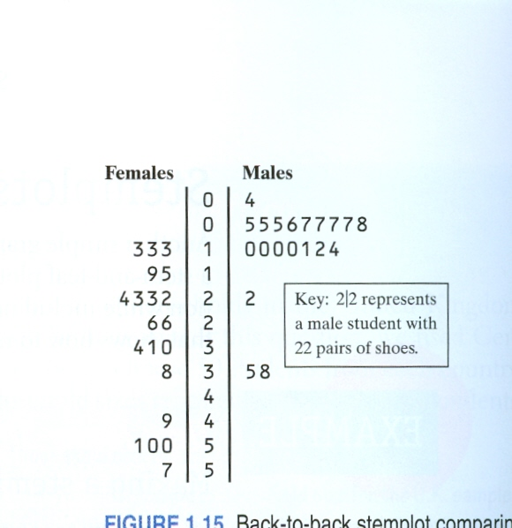
Back to Back Stem Plot
They did the same
survey for the males
14 7 6 5 12 38
8 7 10 10
10 11 4 5 22
7 5 10 35 7
They then made a back to back stem plot of males and females

Slide 24
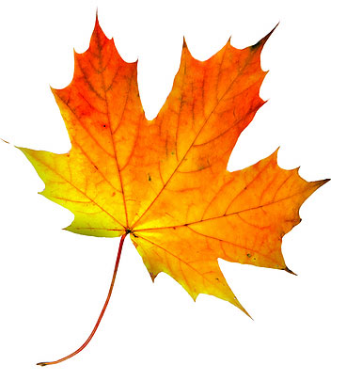
Stem and “LEAF” Plot
Measure your leaf
Write its length on the board
Collect the class data
Create a stemplot from
the class data
Don’t forget the KEY!

Slide 25
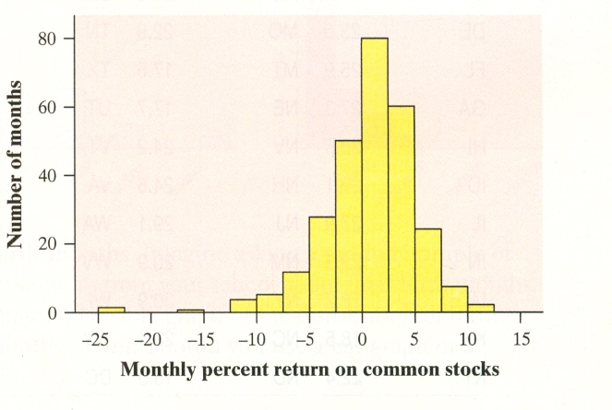
Histograms
Most common graph of the distribution of a quantitative variable

Slide 26
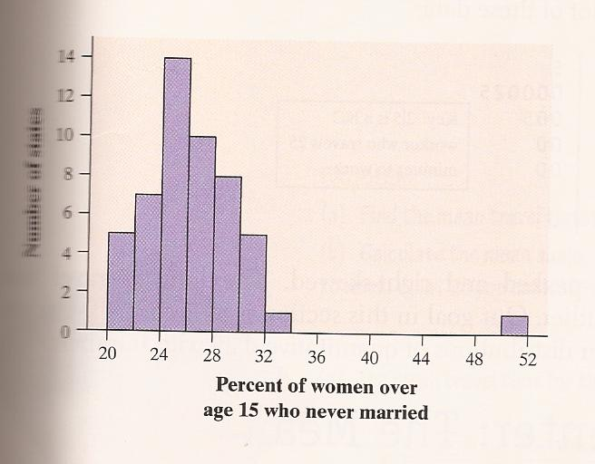
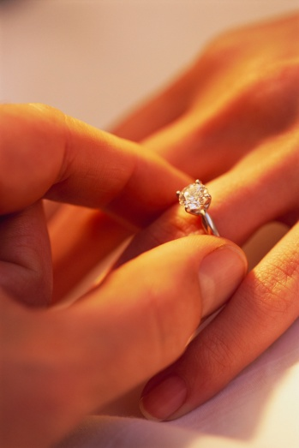
Analyze this!
The histogram below shows the distributions of the percents of women aged 15 and over who have never married in each of the 50 states and the District of Columbia.
SOCS!!

Slide 27
Histograms
How to:
1 – Divide the range of the data into classes of EQUAL width.
2 – LABEL and SCALE axes then draw graph.
3 – Draw a bar that represents the count (or %) in each class.
Tips:
There is no set number of classes, but 5 is good minimum.
Classes must have equal width!
There should be NO SPACE between bars (unless a class has zero observations).

Slide 28
More about Shape
When describing the shape of a distribution, you should focus on the main features – major peaks, outliers, and symmetry or skewness. Also note if there are clusters or gaps.
Symmetric – a distribution is roughly symmetric if the right and left sides of the graph are approximately mirror images of each other. Example:
Skewed Right – a distribution is skewed right if the right side of the graph is much longer than the left side.
Example:
Skewed Left – a distribution is skewed left if the left side of the graph is much longer than the right side.
Example:
**** Distributions are SKEWED TOWARD THE TAIL!!

Slide 29
Bar Graphs vs. Histogram
Bar Graphs
Categorical
Spaces into between bars to separate items compared
Histograms
Quantitative
No space with equal width

Slide 30
Analyzing Qualitative Data
Don’t forget the SOCS!!
Shape
Outliers
Center
Spread

Slide 31
Stemplot Exit Ticket
The following lists the running time (in minutes) of videotape versions of 18 movies directed by Alfred Hitchcock.
Construct a stemplot and describe the distribution.
Film | Time | Film | Time
The Birds | 119 | Psycho | 108
Dial M for Murder | 105 | Rear Window | 113
Family Plot | 120 | Rebecca | 132
Foreign Correspondent | 120 | Vertigo | 128
Frenzy | 116 | Shadow of a Doubt | 108
I Confess | 108 | Spellbound | 111
The Man Who Knew Too Much | 120 | Topaz | 126
Marnie | 130 | Under Capricorn | 117
North by Northwest | 136 | The Paradine Case | 116

Slide 32
HOMEWORK
READ Section 1.1-1.2
(pp. 12-22, 27-35)
DO problems on p. 22/#16, 20, 22, 27-32 and p. 42/#37, 42, 46, 52, 57, 67-74
BE PREPARED for a Quiz!

